Slide 1

CHI-SQUARED TEST

Slide 2
OUTLINE
Background
Introduction to Chi-Square Test
How to Perform Chi-Square Test

Slide 3
BACKGROUND
Group | F1 (age) | F2 (gender)
GA | 12 | Male
 | 54 | Female
 | 23 | Female
 | 47 | Male
 | 23 | Male
 | 53 | Male
 | 32 | Female
GB | 22 | Female
 | 43 | Female
 | 27 | Male
 | 16 | Male
 | 36 | Male
 | 27 | Female
 | 29 | Female
In the case of classification problem where input variables (features) are categorical, we can use statistical test to determine whether the output variable is dependent or independent of the input variables
If independent, then the input variable is a candidate for a feature that may be irrelevant to the problem and removed from the dataset.
Group | F2 (gender) | Total
GA | Male | 4
 | Female | 3
GB | Male | 3
 | Female | 4

Slide 4
CHI-SQUARED TEST
What is chi-square test?
Chi-squared test is designed to analyze categorical data
Intended to test how likely it is that an observed distribution is to be caused by chance
It measures how well the observed distribution of data fits with the distribution that is expected if the variables are independent.
Notes:
Chi-squared test is usually used to test the significant difference between the observation (O) or experiment with the expected result (E).

Slide 5



EXAMPLE OF CHI-SQUARE TEST
You research about preference to spend holiday at the beach, cruise, or hiking between men and women
Does gender affect preferred holiday?
Is that just random chance ?
Or, you have found something interesting ?

Slide 6
UNDERSTANDING P-VALUE
The chi-square gives a “P-Value” to help you to decide
 | Beach (Group A) | Cruise (Group B) | Hiking (Group C)
Men | 209 | 280 | 118
Women | 225 | 248 | 105
By doing calculation, and come up with “P” value :
P < 0.05 is the usual test for dependence
P > 0.05 then variables are independent
Notes:
Does gender (feature) affect preferred holiday (GA: Beach, GB: Cruise, GC: Hiking)?
- if gender does affect preferred holiday, we say that they are dependent

Slide 7
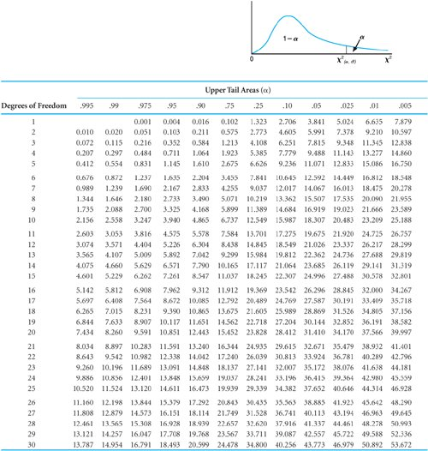


CHI-SQUARE TABLE

Slide 8
HOW TO PERFORM CHI-SQUARE
Collect observed data
Calculate the expected value
Calculate the chi-square points
Calculate the chi-square statistic
Calculate Degree of Freedom (df)
Define Critical Value
Determine decision

Slide 9
VALUES NEED TO DETERMINE AND CALCULATE
Notation | Meaning
 | The chi-square
 | The expected value
 | The observed value
 | Sample size

Slide 10
EXAMPLE & TABLE OF OBSERVED DATA
The preference to spend holiday at beach, cruise, or hiking between men and women
Observed | Men | Women
Beach (GA) | 209 | 225
Cruise (GB) | 280 | 248
Hiking (GC) | 118 | 105
Hypothesis :
Null Hypothesis : Gender and preferred holiday are definitely independent
Alternative Hypothesis : gender and preferred holiday are dependent
Does gender affect preferred holiday?

Slide 11
HOW TO PERFORM CHI-SQUARE
Collect observed data
Calculate the expected value
Calculate the chi-square points
Calculate the chi-square statistic
Calculate Degree of Freedom (df)
Define Critical Value
Determine decision

Slide 12
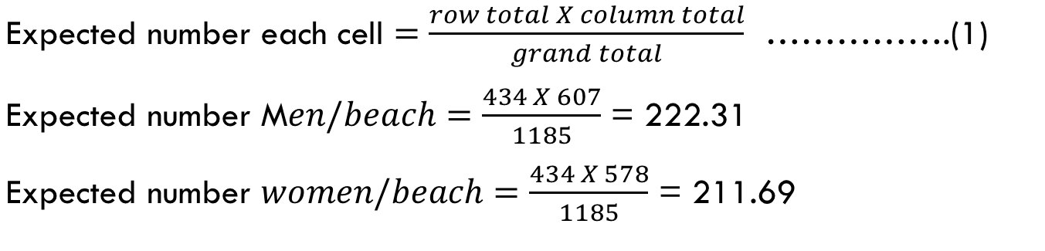
CALCULATE THE EXPECTED VALUE
 | Men | Women | Total
Beach (GA) | 209 | 225 | 434
Cruise (GB) | 280 | 248 | 528
Hiking (GC) | 118 | 105 | 223
Total | 607 | 578 | 1185
 | Men | Women
Beach (GA) | 222.31 | 211.69
Cruise (GB) | 270.46 | 257.54
Hiking (GC) | 114.23 | 108.77

Slide 13
HOW TO PERFORM CHI-SQUARE
Collect observed data
Calculate the expected value
Calculate the chi-square points
Calculate the chi-square statistic
Calculate Degree of Freedom (df)
Define Critical Value
Determine decision

Slide 14
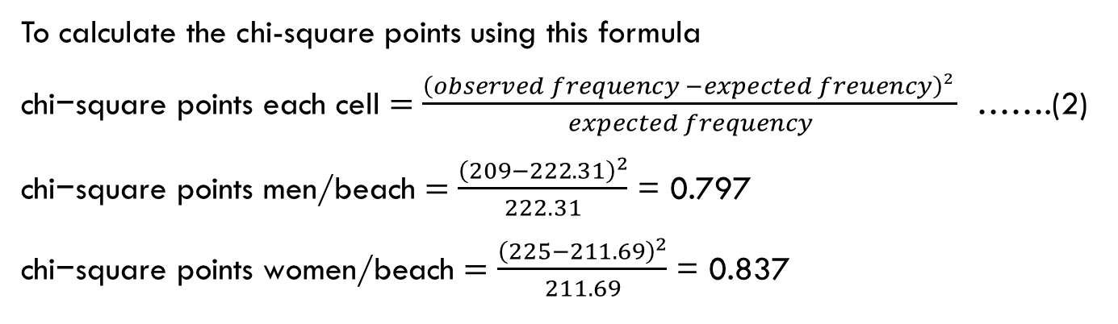
CALCULATE THE CHI-SQUARE POINTS
Group (Output)
 | Men | Women | Men | Women
Beach (GA) | 209 | 225 | 222.31 | 211.69
Cruise (GB) | 280 | 248 | 270.46 | 257.54
Hiking (GC) | 118 | 105 | 114.23 | 108.77
 | Men | Women
Beach (GA) | 0.797 | 0.837
Cruise (GB) | 0.336 | 0.353
Hiking (GC) | 0.125 | 0.131

Slide 15
HOW TO PERFORM CHI-SQUARE
Collect observed data
Calculate the expected value
Calculate the chi-square points
Calculate the chi-square statistic
Calculate Degree of Freedom (df)
Define Critical Value
Determine decision

Slide 16
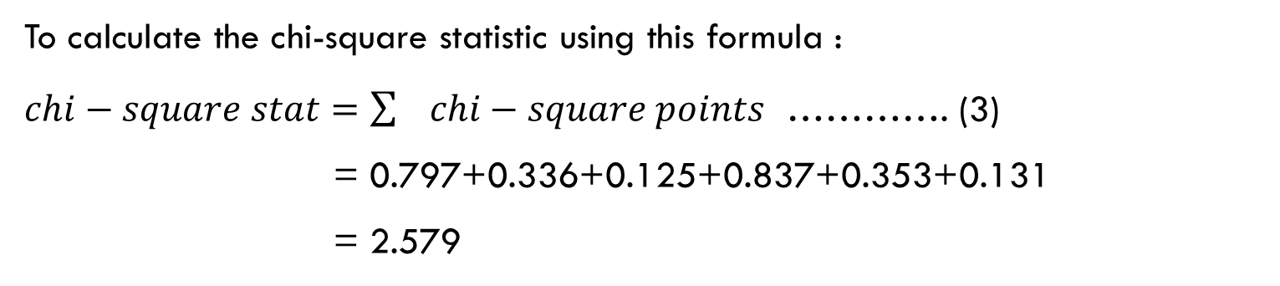
CALCULATE THE CHI-SQUARE STATISTIC
CHI-SQUARE POINTS | Men | Women
Beach (GA) | 0.797 | 0.837
Cruise (GB) | 0.336 | 0.353
Hiking (GC) | 0.125 | 0.131

Slide 17
HOW TO PERFORM CHI-SQUARE
Collect observed data
Calculate the expected value
Calculate the chi-square points
Calculate the chi-square statistic
Calculate Degree of Freedom (df)
Define Critical Value
Determine decision

Slide 18
CALCULATE DEGREE OF FREEDOM (DF)
Observed | Men | Women
Beach (GA) | 209 | 225
Cruise (GB) | 280 | 248
Hiking (GC) | 118 | 105
N = 3
Df = N -1
Df = 3 -1
Df = 2

Slide 19
HOW TO PERFORM CHI-SQUARE
Collect observed data
Calculate the expected value
Calculate the chi-square points
Calculate the chi-square statistic
Calculate Degree of Freedom (df)
Define Critical Value
Determine decision

Slide 20
DEFINE CRITICAL VALUE
Table look up of critical value
df=N-1 = 3-1 =2
Significance level (α)=0.05
Result of critical value: 5.991

Slide 21
HOW TO PERFORM CHI-SQUARE
Collect observed data
Calculate the expected value
Calculate the chi-square points
Calculate the chi-square statistic
Calculate Degree of Freedom (df)
Define Critical Value
Determine decision

Slide 22





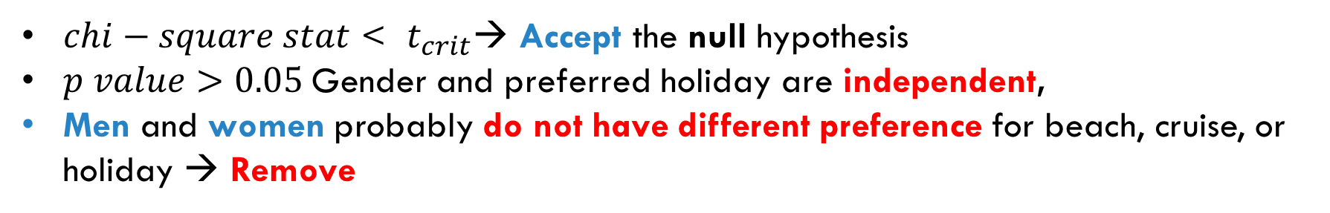
DETERMINE DECISION
Region of rejection
Reject Alternative Hypothesis

Slide 23
CONCLUSION - COMPARISON
Hypothesis Testing | Number of Data for each Group | Type Data | Data Distribution
T-test |  | Real, Number | Assumed: Normal
Wilcoxon test | Same Number | Real, Number | Assumed: Abnormal
Chi square test |  | Categorical
Which one is the best?
None is the best.
All depend on the characteristic of your data, categorical or real number, the data distribution is normal or abnormal

Slide 24
THANK YOU

